Slide 2
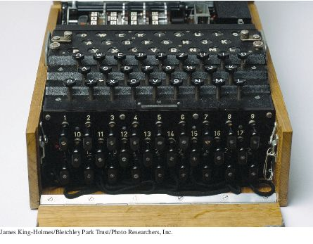
Chapter Goals
To read and write text files
To process command line arguments
To throw and catch exceptions
To implement programs that propagate checked exceptions

Slide 3
Reading and Writing Text Files - Reading
Use Scanner class for reading text files
To read from a disk file:
Construct a File object representing the input file
File inputFile = new File("input.txt");
Use this File object to construct a Scanner object:
Scanner in = new Scanner(reader);
Use the Scanner methods to read data from file
next, nextInt, and nextDouble

Slide 4
Reading and Writing Text Files - Reading
A loop to process numbers in the input file:
while (in.hasNextDouble())
{
double value = in.nextDouble();
Process value.
}

Slide 5
Reading and Writing Text Files - Writing
To write to a file, construct a PrintWriter object:
PrintWriter out = new PrintWriter("output.txt");
If file already exists, it is emptied before the new data are written into it.
If file doesn't exist, an empty file is created.
Use print and println to write into a PrintWriter:
out.println("Hello, World!");
out.printf("Total: %8.2f\n", total);
You must close a file when you are done processing it:
in.close();
out.close();
Otherwise, not all of the output may be written to the disk file.
Always specify "UTF-8" as the second parameter when construction a Scanner or a PrintWriter.

Slide 6
FileNotFoundException
When the input or output file doesn't exist, a FileNotFoundException can occur.
To handle the exception, label the main method like this:
public static void main(String[] args) throws FileNotFoundException

Slide 7
Reading and Writing Text Files - Example
Read a file containing numbers
Sample input
32 54 67.5 29 35 80
115 44.5 100 65
Write the numbers in a column followed by their total
Output from sample input
32.00
54.00
67.50
29.00
35.00
80.00
115.00
44.50
100.00
65.00
Total: 622.00

Slide 8
section_1/Total.java
1 import java.io.File;
2 import java.io.FileNotFoundException;
3 import java.io.PrintWriter;
4 import java.util.Scanner;
5
6 /**
7 This program reads a file with numbers, and writes the numbers to another
8 file, lined up in a column and followed by their total.
9 */
10 public class Total
11 {
12 public static void main(String[] args) throws FileNotFoundException
13 {
14 // Prompt for the input and output file names
15
16 Scanner console = new Scanner(System.in);
17 System.out.print("Input file: ");
18 String inputFileName = console.next();
19 System.out.print("Output file: ");
20 String outputFileName = console.next();
21
22 // Construct the Scanner and PrintWriter objects for reading and writing
23
24 File inputFile = new File(inputFileName);
25 Scanner in = new Scanner(inputFile);
26 PrintWriter out = new PrintWriter(outputFileName);
27
Continued

Slide 9
section_1/Total.java
28 // Read the input and write the output
29
30 double total = 0;
31
32 while (in.hasNextDouble())
33 {
34 double value = in.nextDouble();
35 out.printf("%15.2f\n", value);
36 total = total + value;
37 }
38
39 out.printf("Total: %8.2f\n", total);
40
41 in.close();
42 out.close();
43 }
44 }

Slide 10
Self Check 11.1
What happens when you supply the same name for the input and output files to the Total program? Try it out if you are not sure.
Answer: When the PrintWriter object is created, the output file is emptied. Sadly, that is the same file as the input file. The input file is now empty and the while loop exits immediately.

Slide 11
Self Check 11.2
What happens when you supply the name of a nonexistent input file to the Total program? Try it out if you are not sure.
Answer: The program throws a FileNotFoundException and terminates.

Slide 12
Self Check 11.3
Suppose you wanted to add the total to an existing file instead of writing a new file. Self Check 1 indicates that you cannot simply do this by specifying the same file for input and output. How can you achieve this task? Provide the pseudocode for the solution.
Answer:
Open a scanner for the file.
For each number in the scanner
Add the number to an array.
Close the scanner.
Set total to 0.
Open a print writer for the file.
For each number in the array
Write the number to the print writer.
Add the number to total. Write total to the print writer.
Close the print writer.

Slide 13
Self Check 11.4
How do you modify the program so that it shows the average, not the total, of the inputs?
Answer: Add a variable count that is incremented whenever a number is read. At the end, print the average, not the total, as
out.printf("Average: %8.2f\n", total / count);
Because the string "Average" is three characters longer than "Total", change the other output to
out.printf("%18.2f\n", value);

Slide 14
Self Check 11.5
How can you modify the Total program so that it writes the values in two columns, like this:
32.00 54.00
67.50 29.00
35.00 80.00
115.00 44.50
100.00 65.00
Total: 622.00
Continued

Slide 15
Self Check 11.5
Answer: Add a variable count that is incremented whenever a number is read. Only write a new line when it is even.
count++;
out.printf("%8.2f", value);
if (count % 2 == 0) { out.println(); }
At the end of the loop, write a new line if count is odd, then write the total:
if (count % 2 == 1) { out.println(); }
out.printf("Total: %10.2f\n", total);

Slide 16
Text Input and Output
The next method of the Scanner class reads a string that is delimited by white space.
A loop for processing a file
while (in.hasNext())
{
String input = in.next();
System.out.println(input);
}
If the input is "Mary had a little lamb", the loop prints each word on a separate line
Mary
Had
A
Little
lamb

Slide 17
Text Input and Output
The next method returns any sequence of characters that is not white space.
White space includes: spaces, tab characters, and the newline characters that separate lines.
These strings are considered “words” by the next method
Snow.
1729
C++

Slide 18
Text Input and Output
When next is called:
Input characters that are white space are consumed - removed from the input
They do not become part of the word
The first character that is not white space becomes the first character of the word
More characters are added until
Either another white space character occurs
Or the end of the input file has been reached
If the end of the input file is reached before any character was added to the word
a “no such element exception” occurs.

Slide 19
Text Input and Output
To read just words and discard anything that isn't a letter:
Call useDelimiter method of the Scanner class
Scanner in = new Scanner(. . .);
in.useDelimiter("[^A-Za-z]+");
. . .
The word separator becomes any character that is not a letter.
Punctuation and numbers are not included in the words returned by the next method.

Slide 20
Text Input and Output – Reading Characters
To read one character at a time, set the delimiter pattern to the empty string:
Scanner in = new Scanner(. . .);
in.useDelimiter("");
Now each call to next returns a string consisting of a single character.
To process the characters:
while (in.hasNext())
{
char ch = in.next().charAt(0);
Process ch
}

Slide 21
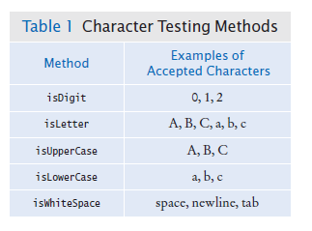
Text Input and Output – Classifying Characters
The Character class has methods for classifying characters.

Slide 22
Text Input and Output – Reading Lines
The nextLine method reads a line of input and consumes the newline character at the end of the line:
String line = in.nextLine();
The hasNextLine method returns true if there are more input lines, false when all lines have been read.
Example: process a file with population data from the CIA Fact Book with lines like this:
China 1330044605
India 1147995898
United States 303824646
...

Slide 23
Text Input and Output – Reading Lines
Read each input line into a string
while (in.hasNextLine())
{
String line = nextLine();
Process line.
}
Then use the isDigit and isWhitespace methods to find out where the name ends and the number starts.
To locate the first digit:
int i = 0;
while (!Character.isDigit(line.charAt(i))) { i++; }
To extract the country name and population:
String countryName = line.substring(0, i);
String population = line.substring(i);

Slide 24
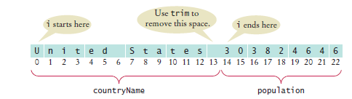
Text Input and Output – Reading Lines
Use trim to remove spaces at the beginning and end of string:
countryName = countryName.trim();
Note that the population is stored in a string.

Slide 25
Text Input and Output – Scanning a String
Occasionally easier to construct a new Scanner object to read the characters from a string:
Scanner lineScanner = new Scanner(line);
Then you can use lineScanner like any other Scanner object, reading words and numbers:
String countryName = lineScanner.next();
while (!lineScanner.hasNextInt())
{
countryName = countryName + " " + lineScanner.next();
}
int populationValue = lineScanner.nextInt();

Slide 26
Text Input and Output - Converting Strings to Numbers
If a string contains the digits of a number.
Use the Integer.parseInt or Double.parseDouble method to obtain the number value.
If the string contains "303824646"
Use Integer.parseInt method to get the integer value
int populationValue = Integer.parseInt(population);
// populationValue is the integer 303824646
If the string contains "3.95"
Use Double.parseDouble
double price = Double.parseDouble(input);
// price is the floating-point number 3.95
The string must not contain spaces or other non-digits. Use trim:
int populationValue = Integer.parseInt(population.trim());

Slide 27
Avoiding Errors When Reading Numbers
If the input is not a properly formatted number when calling nextInt or nextDouble method
input mismatch exception occurs
For example, if the input contains characters:
White space is consumed and the word 21st is read.
21st is not a properly formatted number
Causes an input mismatch exception in the nextInt method.
If there is no input at all when you call nextInt or nextDouble,
A “no such element exception” occurs.
To avoid exceptions, use the hasNextInt method
if (in.hasNextInt()) { int value = in.nextInt(); . . . }

Slide 28
Mixing Number, Word, and Line Input
The nextInt, nextDouble, and next methods do not consume the white space that follows the number or word.
This can be a problem if you alternate between calling nextInt/nextDouble/next and nextLine.
Example: a file contains country names and populations in this format:
China
1330044605
India
1147995898
United States
303824646

Slide 29
Mixing Number, Word, and Line Input
The file is read with these instructions:
while (in.hasNextLine())
{
String countryName = in.nextLine();
int population = in.nextInt();
Process the country name and population.
}

Slide 30


Mixing Number, Word, and Line Input
Initial input
Input after first call to nextLine
Input after call to nextInt
nextInt did not consume the newline character
The second call to nextLine reads an empty string!
The remedy is to add a call to nextLine after reading the population value:
String countryName = in.nextLine();
int population = in.nextInt();
in.nextLine(); // Consume the newline

Slide 31
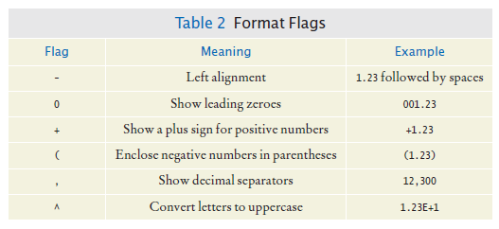
Formatting Output
There are additional options for printf method.
Format flags

Slide 32
Formatting Output
Example: print a table of items and prices, each stored in an array
Cookies: 3.20
Linguine: 2.95
Clams: 17.29
The item strings line up to the left; the numbers line up to the right.

Slide 33
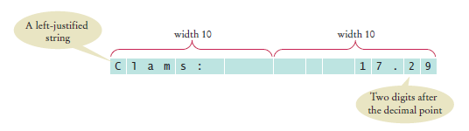
Formatting Output
To specify left alignment, add a hyphen (-) before the field width:
System.out.printf("%-10s%10.2f", items[i] + ":", prices[i]);
There are two format specifiers: "%-10s%10.2f"
%-10s
Formats a left-justified string.
Padded with spaces so it becomes ten characters wide
%10.2f
Formats a floating-point number
The field that is ten characters wide.
Spaces appear to the left and the value to the right
The output

Slide 34
Formatting Output
A format specifier has the following structure:
The first character is a %.
Next are optional “flags” that modify the format, such as - to indicate left alignment.
Next is the field width, the total number of characters in the field (including the spaces used for padding), followed by an optional precision for floating-point numbers.
The format specifier ends with the format type, such as f for floating-point values or s for strings.

Slide 35
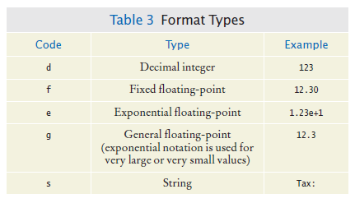
Formatting Output
Format types

Slide 36
Self Check 11.6
Suppose the input contains the characters Hello, World!. What are the values of word and input after this code fragment?
String word = in.next();
String input = in.nextLine();
Answer: word is "Hello", and input is "World!"

Slide 37
Self Check 11.7
Suppose the input contains the characters 995.0 Fred. What are the values of number and input after this code fragment?
int number = 0;
if (in.hasNextInt()) { number = in.nextInt(); }
String input = in.next();
Answer: Because 995.0 is not an integer, the call in.hasNextInt() returns false, and the call in.nextInt() is skipped. The value of number stays 0, and input is set to the string "995.0".

Slide 38
Self Check 11.8
Suppose the input contains the characters 6E6 6,995.00. What are the values of x1 and x2 after this code fragment?
double x1 = in.nextDouble();
double x2 = in.nextDouble();
Answer: x1 is set to 6000000. Because a comma is not considered a part of a floating-point number in Java, the second call to nextDouble causes an input mismatch exception and x2 is not set.

Slide 39
Self Check 11.9
Your input file contains a sequence of numbers, but sometimes a value is not available and marked as N/A. How can you read the numbers and skip over the markers?
Answer: Read them as strings, and convert those strings to numbers that are not equal to N/A:
String input = in.next();
if (!input.equals("N/A"))
{
double value = Double.parseDouble(input);
Process value
}

Slide 40
Self Check 11.10
How can you remove spaces from the country name in Section 11.2.4 without using the trim method?
Answer: Locate the last character of the country name:
int j = i – 1;
while (!Character.isWhiteSpace(line.charAt(j)))
{
j--;
}
Then extract the country name:
String countryName = line.substring(0, j + 1);

Slide 41
Command Line Arguments
You can run a Java program by typing a command at the prompt in the command shell window
Called “invoking the program from the command line”
With this method, you can add extra information for the program to use
Called command line arguments
Example: start a program with a command line
java ProgramClass -v input.dat
The program receives the strings "-v" and "input.dat" as command line arguments
Useful for automating tasks

Slide 42
Command Line Arguments
Your program receives its command line arguments in the args parameter of the main method:
public static void main(String[] args)
In the example, args is an array of length 2, containing the strings
args[0]: "-v”
args[1]: "input.dat"

Slide 43

Command Line Arguments
Example: a program that encrypts a file
Use a Caesar Cipher that replaces A with a D, B with an E, and so on
Sample text
The program will take command line arguments
An optional -d flag to indicate decryption instead of encryption
The input file name
The output file name
To encrypt the file input.txt and place the result into encrypt.txt
java CaesarCipher input.txt encrypt.txt
To decrypt the file encrypt.txt and place the result into output.txt
java CaesarCipher -d encrypt.txt output.txt

Slide 44
section_3/CaesarCipher.java
1 import java.io.File;
2 import java.io.FileNotFoundException;
3 import java.io.PrintWriter;
4 import java.util.Scanner;
5
6 /**
7 This program encrypts a file using the Caesar cipher.
8 */
9 public class CaesarCipher
10 {
11 public static void main(String[] args) throws FileNotFoundException
12 {
13 final int DEFAULT_KEY = 3;
14 int key = DEFAULT_KEY;
15 String inFile = "";
16 String outFile = "";
17 int files = 0; // Number of command line arguments that are files
18
Continued

Slide 45
section_3/CaesarCipher.java
19 for (int i = 0; i < args.length; i++)
20 {
21 String arg = args[i];
22 if (arg.charAt(0) == &apos;-&apos;)
23 {
24 // It is a command line option
25
26 char option = arg.charAt(1);
27 if (option == &apos;d&apos;) { key = -key; }
28 else { usage(); return; }
29 }
30 else
31 {
32 // It is a file name
33
34 files++;
35 if (files == 1) { inFile = arg; }
36 else if (files == 2) { outFile = arg; }
37 }
38 }
39 if (files != 2) { usage(); return; }
40
Continued

Slide 46
section_3/CaesarCipher.java
41 Scanner in = new Scanner(new File(inFile));
42 in.useDelimiter(""); // Process individual characters
43 PrintWriter out = new PrintWriter(outFile);
44
45 while (in.hasNext())
46 {
47 char from = in.next().charAt(0);
48 char to = encrypt(from, key);
49 out.print(to);
50 }
51 in.close();
52 out.close();
53 }
54
Continued

Slide 47
section_3/CaesarCipher.java
55 /**
56 Encrypts upper- and lowercase characters by shifting them
57 according to a key.
58 @param ch the letter to be encrypted
59 @param key the encryption key
60 @return the encrypted letter
61 */
62 public static char encrypt(char ch, int key)
63 {
64 int base = 0;
65 if (&apos;A&apos; <= ch && ch <= &apos;Z&apos;) { base = &apos;A&apos;; }
66 else if (&apos;a&apos; <= ch && ch <= &apos;z&apos;) { base = &apos;a&apos;; }
67 else { return ch; } // Not a letter
68 int offset = ch - base + key;
69 final int LETTERS = 26; // Number of letters in the Roman alphabet
70 if (offset > LETTERS) { offset = offset - LETTERS; }
71 else if (offset < 0) { offset = offset + LETTERS; }
72 return (char) (base + offset);
73 }
74
75 /**
76 Prints a message describing proper usage.
77 */
78 public static void usage()
79 {
80 System.out.println("Usage: java CaesarCipher [-d] infile outfile");
81 }
82 }

Slide 48
Self Check 11.11
If the program is invoked with
java CaesarCipher -d file1.txt
what are the elements of args?
Answer: args[0] is "-d" and args[1] is "file1.txt"

Slide 49
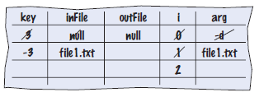
Self Check 11.12
Trace the program when it is invoked as in Self Check 11.
Answer:
Then the program prints a message
Usage: java CaesarCipher [-d] infile outfile

Slide 50
Self Check 11.13
Will the program run correctly if the program is invoked with
java CaesarCipher file1.txt file2.txt –d
If so, why? If not, why not?
Answer: The program will run correctly. The loop that parses the options does not depend on the positions in which the options appear.

Slide 51
Self Check 11.14
Encrypt CAESAR using the Caesar cipher.
Answer: FDHVDU

Slide 52
Self Check 11.15
How can you modify the program so that the user can specify an encryption key other than 3 with a -k option, for example
java CaesarCipher -k15 input.txt output.txt
Answer: Add the lines
else if (option == 'k’)
{
key = Integer.parseInt( args[i].substring(2));
}
after line 27 and update the usage information.

Slide 53
Exception Handling - Throwing Exceptions
Exception handling provides a flexible mechanism for passing control from the point of error detection to a handler that can deal with the error.
When you detect an error condition, throw an exception object to signal an exceptional condition
If someone tries to withdraw too much money from a bank account
Throw an IllegalArgumentException
IllegalArgumentException exception =
new IllegalArgumentException("Amount exceeds balance");
throw exception;

Slide 54
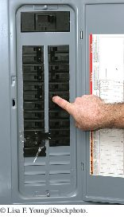
Exception Handling - Throwing Exceptions
When an exception is thrown, method terminates immediately
Execution continues with an exception handler
When you throw an exception, the normal control flow is terminated. This is similar to a circuit breaker that cuts off the flow of electricity in a dangerous situation.

Slide 55
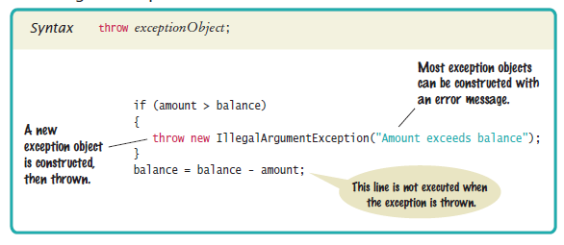
Syntax 11.1 Throwing an Exception

Slide 56
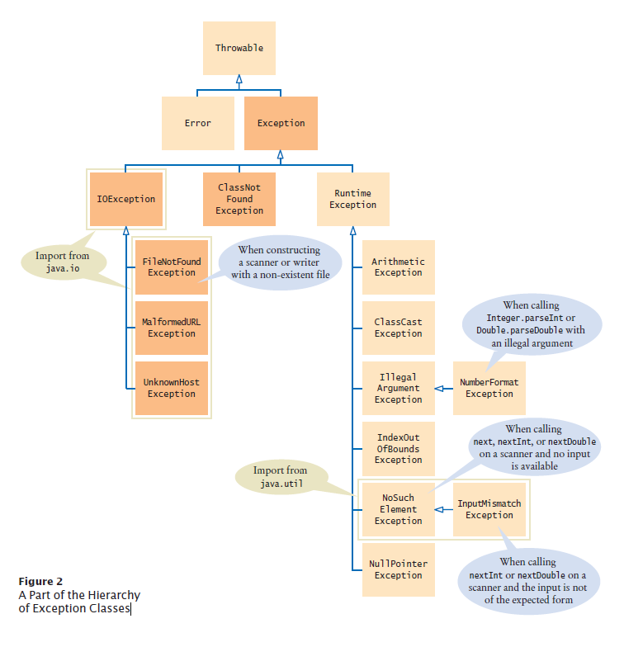
Hierarchy of Exception Classes
Figure 2 A Part of the Hierarchy of Exception Classes

Slide 57
Catching Exceptions
Every exception should be handled somewhere in your program
Place the statements that can cause an exception inside a try block, and the handler inside a catch clause.
try
{
String filename = . . .;
Scanner in = new Scanner(new File(filename));
String input = in.next();
int value = Integer.parseInt(input);
. . .
}
catch (IOException exception)
{
exception.printStackTrace();
}
catch (NumberFormatException exception)
{
System.out.println(exception.getMessage());
}

Slide 58
Catching Exceptions
Three exceptions may be thrown in the try block:
The Scanner constructor can throw a FileNotFoundException.
Scanner.next can throw a NoSuchElementException.
Integer.parseInt can throw a NumberFormatException.
If any of these exceptions is actually thrown, then the rest of the instructions in the try block are skipped.

Slide 59
Catching Exceptions
What happens when each exception is thrown:
If a FileNotFoundException is thrown,
then the catch clause for the IOException is executed because FileNotFoundException is a descendant of IOException.
If you want to show the user a different message for a FileNotFoundException, you must place the catch clause before the clause for an IOException
If a NumberFormatException occurs,
then the second catch clause is executed.
A NoSuchElementException is not caught by any of the catch clauses.
The exception remains thrown until it is caught by another try block.

Slide 60
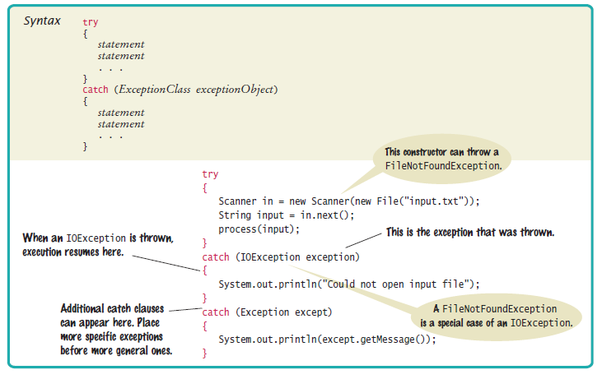
Syntax 11.2 Catching Exceptions

Slide 61

Catching Exceptions
Each catch clause contains a handler.
Our example just informed the user of a problem.
Often better to give the user another chance.
When you throw an exception, you can provide your own message string.
For example, when you call
throw new IllegalArgumentException("Amount exceeds balance");
the message of the exception is the string provided in the constructor.
You should only catch those exceptions that you can handle.

Slide 62
Checked Exceptions
Exceptions fall into three categories
Internal errors are reported by descendants of the type Error.
Example: OutOfMemoryError
Descendants of RuntimeException,
Example: IndexOutOfBoundsException or IllegalArgumentException
Indicate errors in your code.
They are called unchecked exceptions.
All other exceptions are checked exceptions.
Indicate that something has gone wrong for some external reason beyond your control
Example: IOException

Slide 63
Checked Exceptions
Checked exceptions are due to external circumstances that the programmer cannot prevent.
The compiler checks that your program handles these exceptions.
The unchecked exceptions are your fault.
The compiler does not check whether you handle an unchecked exception.

Slide 64
Checked Exceptions - throws
You can handle the checked exception in the same method that throws it
try
{
File inFile = new File(filename);
Scanner in = new Scanner(inFile); // ThrowsFileNotFoundException
. . .
}
catch (FileNotFoundException exception) // Exception caught here
{
. . .
}

Slide 65
Checked Exceptions - throws
Often the current method cannot handle the exception. Tell the compiler you are aware of the exception
You want the method to terminate if the exception occurs
Add a throws clause to the method header
public void readData(String filename) throws FileNotFoundException
{
File inFile = new File(filename);
Scanner in = new Scanner(inFile);
. . .
}

Slide 66

Checked Exceptions - throws
The throws clause signals to the caller of your method that it may encounter a FileNotFoundException.
The caller must decide
To handle the exception
Or declare the exception may be thrown
Throw early, catch late
Throw an exception as soon as a problem is detected.
Catch it only when the problem can be handled
Just as trucks with large or hazardous loads carry warning signs, the throws clause warns the caller that an exception may occur.

Slide 67
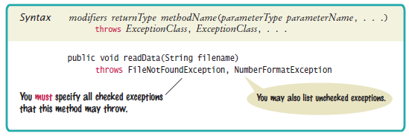
Syntax 11.3 throws Clause

Slide 68
The finally Clause
Once a try block is entered, the statements in a finally clause are guaranteed to be executed - whether or not an exception is thrown.
Use when you do some clean up
Example - closing files
PrintWriter out = new PrintWriter(filename);
try
{
writeData(out);
}
finally
{
out.close();
}
Executes the close even if an exception is thrown.

Slide 69

The finally Clause
All visitors to a foreign country have to go through passport control, no matter what happened on their trip. Similarly, the code in a finally clause is always executed, even when an exception has occurred.

Slide 70
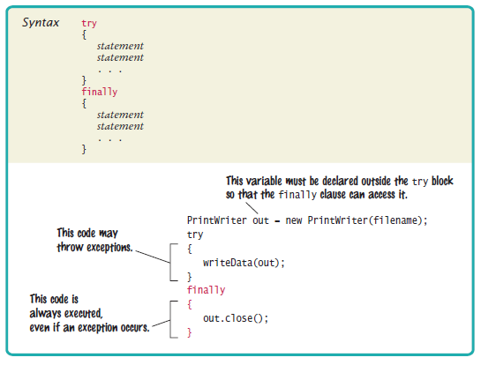
Syntax 11.4 finally Clause

Slide 71
Designing Your Own Exception Types
You can design your own exception types — subclasses of Exception or RuntimeException.
Throw an InsufficientFundsException when the amount to withdraw an amount from a bank account exceeds the current balance.
if (amount > balance)
{
throw new InsufficientFundsException( "withdrawal of " +
amount + " exceeds balance of " + balance);
}
Make InsufficientFundsException an unchecked exception
Programmer could have avoided it by calling getBalance first
Extend RuntimeException or one of its subclasses

Slide 72
Designing Your Own Exception Types
Supply two constructors for the class
A constructor with no arguments
A constructor that accepts a message string describing reason for exception
public class InsufficientFundsException extends RuntimeException
{
public InsufficientFundsException() {}
public InsufficientFundsException(String message)
{
super(message);
}
}
When the exception is caught, its message string can be retrieved
Using the getMessage method of the Throwable class.

Slide 73
Self Check 11.16
Suppose balance is 100 and amount is 200. What is the value of balance after these statements?
if (amount > balance)
{
throw new IllegalArgumentException("Amount exceeds balance");
}
balance = balance – amount;
Answer: It is still 100. The last statement was not executed because the exception was thrown.

Slide 74
Self Check 11.17
When depositing an amount into a bank account, we don’t have to worry about overdrafts—except when the amount is negative. Write a statement that throws an appropriate exception in that case.
Answer:
if (amount < 0)
{
throw new IllegalArgumentException("Negative amount");
}

Slide 75
Self Check 11.18
Consider the method
public static void main(String[] args)
{
try
{
Scanner in = new Scanner(new File("input.txt"));
int value = in.nextInt();
System.out.println(value);
}
catch (IOException exception)
{
System.out.println("Error opening file.");
}
}
Suppose the file with the given file name exists and has no contents. Trace the flow of execution.
Continued

Slide 76
Self Check 11.18
Answer: The Scanner constructor succeeds because the file exists. The nextInt method throws a NoSuchElementException. This is not an IOException. Therefore, the error is not caught. Because there is no other handler, an error message is printed and the program terminates.

Slide 77
Self Check 11.19
Why is an ArrayIndexOutOfBoundsException not a checked exception?
Answer: Because programmers should simply check that their array index values are valid instead of trying to handle an ArrayIndexOutOfBoundsException.

Slide 78
Self Check 11.20
Is there a difference between catching checked and unchecked exceptions?
Answer: No. You can catch both exception types in the same way, as you can see in the code example on page 536.

Slide 79
Self Check 11.21
What is wrong with the following code, and how can you fix it?
public static void writeAll(String[] lines, String filename)
{
PrintWriter out = new PrintWriter(filename);
for (String line : lines)
{
out.println(line.toUpperCase());
}
out.close();
}
Answer: There are two mistakes. The PrintWriter constructor can throw a FileNotFoundException. You should supply a throws clause. And if one of the array elements is null, a NullPointerException is thrown. In that case, the out.close() statement is never executed. You should use a try/finally statement.

Slide 80
Self Check 11.22
What is the purpose of the call super(message) in the second InsufficientFundsException constructor?
Answer: To pass the exception message string to the IllegalArgumentException superclass.

Slide 81
Self Check 11.23
Suppose you read bank account data from a file. Contrary to your expectation, the next input value is not of type double. You decide to implement a BadDataException. Which exception class should you extend?
Answer: Because file corruption is beyond the control of the programmer, this should be a checked exception, so it would be wrong to extend RuntimeException or IllegalArgumentException. Because the error is related to input, IOException would be a good choice.

Slide 82
Application: Handling Input Errors
Program asks user for name of file
File expected to contain data values
First line of file contains total number of values
Remaining lines contain the data
Typical input file:
3
1.45
-2.1
0.05

Slide 83
Case Study: A Complete Example
What can go wrong?
File might not exist
File might have data in wrong format
Who can detect the faults?
Scanner constructor will throw an exception when file does not exist
Methods that process input need to throw exception if they find error in data format
What exceptions can be thrown?
FileNotFoundException can be thrown by Scanner constructor
BadDataException, a custom checked exception class for reporting wrong data format

Slide 84
Case Study: A Complete Example
Who can remedy the faults that the exceptions report?
Only the main method of DataAnalyzer program interacts with user
Catches exceptions
Prints appropriate error messages
Gives user another chance to enter a correct file

Slide 85
section_5/DataAnalyzer.java
1 import java.io.FileNotFoundException;
2 import java.io.IOException;
3 import java.util.Scanner;
4
5 /**
6 This program reads a file containing numbers and analyzes its contents.
7 If the file doesn&apos;t exist or contains strings that are not numbers, an
8 error message is displayed.
9 */
10 public class DataAnalyzer
11 {
12 public static void main(String[] args)
13 {
14 Scanner in = new Scanner(System.in);
15 DataSetReader reader = new DataSetReader();
16
Continued

Slide 86
section_5/DataAnalyzer.java
17 boolean done = false;
18 while (!done)
19 {
20 try
21 {
22 System.out.println("Please enter the file name: ");
23 String filename = in.next();
24
25 double[] data = reader.readFile(filename);
26 double sum = 0;
27 for (double d : data) { sum = sum + d; }
28 System.out.println("The sum is " + sum);
29 done = true;
30 }
31 catch (FileNotFoundException exception)
32 {
33 System.out.println("File not found.");
34 }
35 catch (BadDataException exception)
36 {
37 System.out.println("Bad data: " + exception.getMessage());
38 }
39 catch (IOException exception)
40 {
41 exception.printStackTrace();
42 }
43 }
44 }
45 }

Slide 87
The readFile Method of the DataSetReader Class
Constructs Scanner object
Calls readData method
Completely unconcerned with any exceptions
If there is a problem with input file, it simply passes the exception to caller:
public double[] readFile(String filename) throws IOException
{
File inFile = new File(filename);
Scanner in = new Scanner(inFile);
try
{
readData(in);
return data;
}
finally { in.close(); }
}

Slide 88
The readData Method of the DataSetReader Class
Reads the number of values
Constructs an array
Calls readValue for each data value:
private void readData(Scanner in) throws BadDataException
{
if (!in.hasNextInt())
{
throw new BadDataException("Length expected");
}
int numberOfValues = in.nextInt();
data = new double[numberOfValues];
for (int i = 0; i < numberOfValues; i++)
readValue(in, i);
if (in.hasNext())
throw new BadDataException("End of file expected");
}

Slide 89
The readData Method of the DataSetReader Class
Checks for two potential errors:
File might not start with an integer
File might have additional data after reading all values.
Makes no attempt to catch any exceptions.

Slide 90
The readValue Method of the DataSetReader Class
private void readValue(Scanner in, int i) throws BadDataException
{
if (!in.hasNextDouble())
throw new BadDataException("Data value expected");
data[i] = in.nextDouble();
}

Slide 91
Error Scenario
DataAnalyzer.main calls DataSetReader.readFile
readFile calls readData
readData calls readValue
readValue doesn't find expected value and throws BadDataException
readValue has no handler for exception and terminates
readData has no handler for exception and terminates
readFile has no handler for exception and terminates after executing finally clause and closing the Scanner object
DataAnalyzer.main has handler for BadDataException
Handler prints a message
User is given another chance to enter file name

Slide 92
section_5/DataSetReader.java
1 import java.io.File;
2 import java.io.IOException;
3 import java.util.Scanner;
4
5 /**
6 Reads a data set from a file. The file must have the format
7 numberOfValues
8 value1
9 value2
10 . . .
11 */
12 public class DataSetReader
13 {
14 private double[] data;
15
Continued

Slide 93
section_5/DataSetReader.java
16 /**
17 Reads a data set.
18 @param filename the name of the file holding the data
19 @return the data in the file
20 */
21 public double[] readFile(String filename) throws IOException
22 {
23 File inFile = new File(filename);
24 Scanner in = new Scanner(inFile);
25 try
26 {
27 readData(in);
28 return data;
29 }
30 finally
31 {
32 in.close();
33 }
34 }
35
Continued

Slide 94
section_5/DataSetReader.java
36 /**
37 Reads all data.
38 @param in the scanner that scans the data
39 */
40 private void readData(Scanner in) throws BadDataException
41 {
42 if (!in.hasNextInt())
43 {
44 throw new BadDataException("Length expected");
45 }
46 int numberOfValues = in.nextInt();
47 data = new double[numberOfValues];
48
49 for (int i = 0; i < numberOfValues; i++)
50 {
51 readValue(in, i);
52 }
53
54 if (in.hasNext())
55 {
56 throw new BadDataException("End of file expected");
57 }
58 }
59
Continued

Slide 95
section_5/DataSetReader.java
60 /**
61 Reads one data value.
62 @param in the scanner that scans the data
63 @param i the position of the value to read
64 */
65 private void readValue(Scanner in, int i) throws BadDataException
66 {
67 if (!in.hasNextDouble())
68 {
69 throw new BadDataException("Data value expected");
70 }
71 data[i] = in.nextDouble();
72 }
73 }

Slide 96
section_5/BadDataException.java
1 import java.io.IOException;
2
3 /**
4 This class reports bad input data.
5 */
6 public class BadDataException extends IOException
7 {
8 public BadDataException() {}
9 public BadDataException(String message)
10 {
11 super(message);
12 }
13 }

Slide 97
Self Check 11.24
Why doesn't the DataSetReader.readFile method catch any exceptions?
Answer: It would not be able to do much with them. The DataSetReader class is a reusable class that may be used for systems with different languages and different user interfaces. Thus, it cannot engage in a dialog with the program user.

Slide 98
Self Check 11.25
Suppose the user specifies a file that exists and is empty. Trace the flow of execution.
Answer: DataAnalyzer.main calls DataSetReader.readFile, which calls readData. The call in.hasNextInt() returns false, and readData throws a BadDataException. The readFile method doesn't catch it, so it propagates back to main, where it is caught.

Slide 99
Self Check 11.26
If the readValue method had to throw a NoSuchElementException instead of a BadDataException when the next input isn’t a floating-point number, how would the implementation change?
Answer: It could simply be
private void readValue(Scanner in, int i)
{
data[i] = in.nextDouble();
}
The nextDouble method throws a NoSuchElementException or a InputMismatchException (which is a subclass of NoSuchElementException) when the next input isn’t a floating-point number. That exception isn’t a checked exception, so it need not be declared.

Slide 100
Self Check 11.27
Consider the try/finally statement in the readFile method. Why was the in variable declared outside the try block?
Answer: If it had been declared inside the try block, its scope would only have extended until the end of the try block, and it would not have been accessible in the finally clause.

Slide 101
Self Check 11.28
How can the program be simplified when you use the “automatic resource management” feature described in Special Topic 11.6?
Answer: The try/finally statement in the readFile method can be rewritten as
try (Scanner in = new Scanner(inFile))
{
readData(in);
return data;
}

